Slide 1


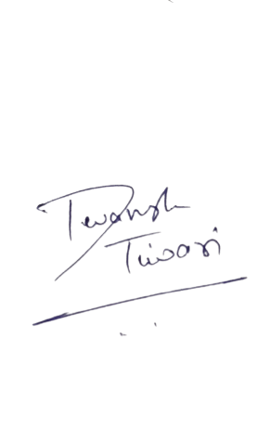

Team
est. June 1, 2021
expanD
Expand your child's potential.
Give the power of future in their hands.
Founder of expanD
CEO

Slide 2



Introduction
est.
June 1, 2021
Sushant Bisht and Devansh Tiwari have started this organization you help students to get perfection in the field of computing.
The goal of our session is to turn chaos into clarity. As our role is to keep the session on track and to ensure that everyone is provided with the best quality education in field they are interested in.
Sushant Bisht
Devansh Tiwari

Slide 3




Courses
What expanD provides you?
1
Web Development
2
Competitive Coding
3
Data Structures
4
Algorithm
expanD provides you numbers of courses in computers. You can enroll any of the course and get perfection in that.
Signup now!!

Slide 4


est.
June 1, 2021
Are you ready?
Let's Start!

Slide 5
Team expanD
est.
June 1, 2021
How expanD works ?
1
As the world is constantly moving towards electronics, coding has now become a must known skill. Expand your child's potential. Give the power of future in their hands.
How expanD benefits learners ?
2
3
How to get course registration for free.
4
How to get Subscription and private classes with expanD

Slide 6


How expanD works ?
Problem Solving Skills
Profitable Market
Certified Guidance
expand provides you course you are interested in.
We store you data in our database for further validations. We provides learners with best quality education.
We provide many more services and keep a regular progress record of students those have taken our membership.
Well we help you in building stairs to catch up your dreams!
Signup now!

Slide 7
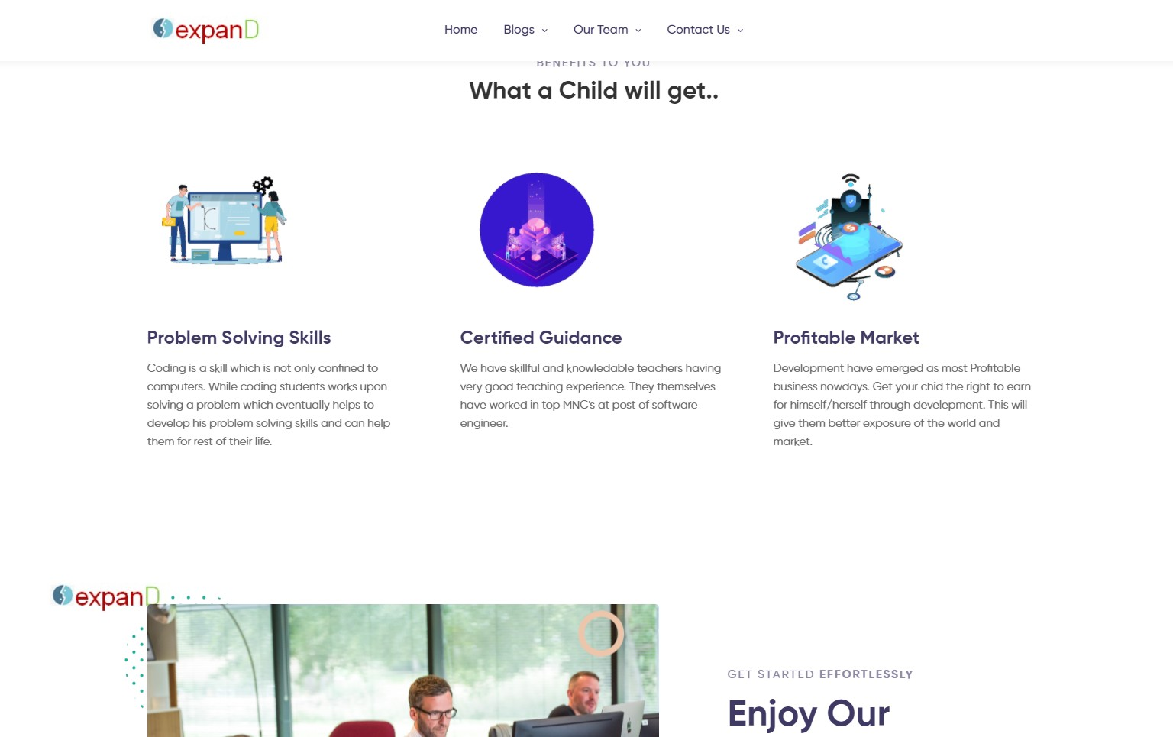

Microsoft SQL Server Certificatio ns
SAP
Certified Technology Associate
Oracle Certified Professiona l
How expanD benefits learners ?
A computer science certification can verify your skills to employers, qualifying you for more advanced positions and increasing your earning potential. They can even help with job retention by making you more valuable to your current employer. Evaluating the best computer science certifications that are available can help you determine which are the best for your skills and career path
Signup now!

Slide 8



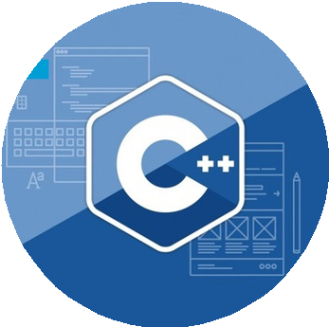


Registration
est.
June 1, 2021
You can register with expanD for free and can get membership at very low cost so hurry and join us now!!!
1
Visit expanD official website
2
Click on 'Get Started'
3
Fill all your details in form
4
Click on Sign up and you are done!!!
web development
yes!
Data structure
algo
this is
great
competitive coding
c++,python,c
wordpress,ht
,java
ml,css

Slide 9

est.
June 1, 2021
"Your interest in field you like, describe your determination in it...!"
Sushant Bisht (expanD)

Slide 10

Thank You !
est.
June 1, 2021
Expand your child's potential. Give the power of future in their hands.

